Slide 1
Naïve Bayes
classifier

Slide 2
Classification Workflow
Whenever you perform classification, the first step is to understand the problem and identify potential features and label.
Features are those characteristics or attributes which affect the results of the label.
For example, in the case of a loan distribution, bank manager's identify customer’s occupation, income, age, location, previous loan history, transaction history, and credit score. These characteristics are known as features which help the model classify customers.

Slide 3
classification
The classification has two phases, a learning phase, and the evaluation phase.
In the learning phase, classifier trains its model on a given dataset.
in the evaluation phase, it tests the classifier performance.
Performance is evaluated on the basis of various parameters such as accuracy, error, precision, and recall.

Slide 4


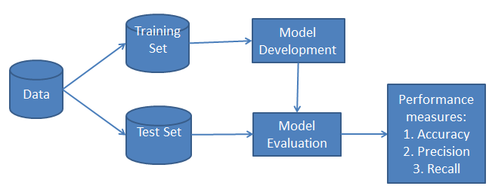

Slide 5
What is Naive Bayes Classifier?
Naive Bayes is a statistical classification technique based on Bayes Theorem.
Naive Bayes classifier is the fast, accurate and reliable algorithm. Naive Bayes classifiers have high accuracy and speed on large datasets.
Naive Bayes classifier assumes that the effect of a particular feature in a class is independent of other features.
For example, a loan applicant is desirable or not depending on his/her income, previous loan and transaction history, age, and location. Even if these features are interdependent, these features are still considered independently.
This assumption simplifies computation, and that's why it is considered as naive. This assumption is called class conditional independence.

Slide 6

Naïve bayes
P(h): the probability of hypothesis h being true (regardless of the data). This is known as the prior probability of h.
P(D): the probability of the data (regardless of the hypothesis). This is known as the prior probability.
P(h|D): the probability of hypothesis h given the data D. This is known as posterior probability.
P(D|h): the probability of data d given that the hypothesis h was true.

Slide 7
How Naive Bayes classifier works?
Let’s understand the working of Naive Bayes through an example.
Given an example of weather conditions and playing sports. You need to calculate the probability of playing sports.
Now, you need to classify whether players will play or not, based on the weather condition.

Slide 8
First Approach (In case of a single feature)
Naive Bayes classifier calculates the probability of an event in the following steps:
Step 1: Calculate the prior probability for given class labels
Step 2: Find Likelihood probability with each attribute for each class
Step 3: Put these value in Bayes Formula and calculate posterior probability.
Step 4: See which class has a higher probability, given the input belongs to the higher probability class.

Slide 9
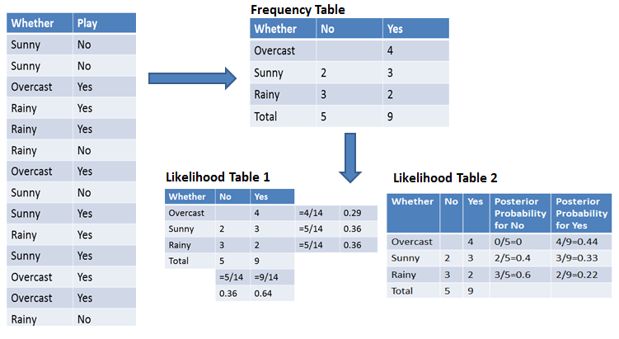
frequency and likelihood tables
The Frequency table contains the occurrence of labels for all features.
Likelihood Table 1 is showing prior probabilities of labels
Likelihood Table 2 is showing the posterior probability.

Slide 10
the probability of playing when the weather is overcast
Probability of playing:
P(Yes | Overcast) = P(Overcast | Yes) P(Yes) / P (Overcast) .....................(1)
Calculate Prior Probabilities:
P(Overcast) = 4/14 = 0.29
P(Yes)= 9/14 = 0.64
Calculate Posterior Probabilities:
P(Overcast |Yes) = 4/9 = 0.44
Put Prior and Posterior probabilities in equation (1)
P (Yes | Overcast) = 0.44 * 0.64 / 0.29 = 0.98(Higher)

Slide 11
the probability of not playing when the weather is overcast
Probability of not playing:
P(No | Overcast) = P(Overcast | No) P(No) / P (Overcast) .....................(2)
Calculate Prior Probabilities:
P(Overcast) = 4/14 = 0.29
P(No)= 5/14 = 0.36
Calculate Posterior Probabilities:
P(Overcast |No) = 0/9 = 0
Put Prior and Posterior probabilities in equation (2)
P (No | Overcast) = 0 * 0.36 / 0.29 = 0
The probability of a 'Yes' class is higher. So you can determine here if the weather is overcast than players will play the sport.

Slide 12
Zero Probability Problem
Suppose there is no tuple for a risky loan in the banking dataset, in this scenario, the posterior probability will be zero.
and the model is unable to make a prediction. This problem is known as Zero Probability because the occurrence of the particular class is zero.
The solution for such an issue is the Laplacian correction or Laplace Transformation.
Laplacian correction is one of the smoothing techniques.
Here, you can assume that the dataset is large enough that adding one row of each class will not make a difference in the estimated probability. This will overcome the issue of probability values to zero.

Slide 13

Zero Probability Problem
For Example: Suppose that for the class loan risky, there are 1000 training tuples in the database.
In this database, income column has 0 tuples for low income, 990 tuples for medium income, and 10 tuples for high income.
The probabilities of these events, without the Laplacian correction, are 0, 0.990 (from 990/1000), and 0.010 (from 10/1000)
Now, apply Laplacian correction on the given dataset. Let's add 1 more tuple for each income-value pair. The probabilities of these events:

Slide 14
Advantages
It is not only a simple approach but also a fast and accurate method for prediction.
Naive Bayes has very low computation cost.
It can efficiently work on a large dataset.
It performs well in case of discrete response variable compared to the continuous variable.
It can be used with multiple class prediction problems.
It also performs well in the case of text analytics problems.
When the assumption of independence holds, a Naive Bayes classifier performs better compared to other models like logistic regression.

Slide 15
Disadvantages
The assumption of independent features. In practice, it is almost impossible that model will get a set of predictors which are entirely independent.
If there is no training tuple of a particular class, this causes zero posterior probability. In this case, the model is unable to make predictions. This problem is known as Zero Probability/Frequency Problem.

